Slide 1
Occupational Specialist Component Content: Digital Production, Design and Development
The T Level T Level Technical Qualification in Digital: Digital Production, Design and Development includes a single Occupational Specialist Component. Therefore, there is a single synoptic assessment for the Occupational Specialist Component, which is an extended ‘design, development and implementation’ project. The synoptic element of the project is important in order to ensure that students are able to demonstrate threshold competence: this is the principal reason why the Occupational Specialism is assessed via a single extended project assessment to ensure that students are able to evidence all the skills required by the Performance Outcomes.
The T Level Technical Qualification in Digital: Digital Production, Design and Development Occupational Specialist Component consists of several activities grouped into four substantive tasks.
Each task will be completed during a window set by Pearson during which you will schedule supervised assessment sessions. In some cases, tasks will also involve opportunities for unsupervised activities where the requirements of the skills being assessed make this necessary.

Slide 2
The unit outcomes
1.2 Understand the roles and responsibilities of the digital team within the software development lifecycle
Product owner/client – sets and communicates the requirements of the product.
Scrum Master – facilitates the team to maintain team cohesion, ensuring the team has access to resources they require.
Technical Lead – provide the technical guidance and support for the project team.
Project Manager – responsible for planning, organizing, managing (budget, scope, schedule, risk and quality) on all phases of a project.
Software Development Team
Systems Analyst – analyses the current system and provides the requirements for the new system – uses the requirements to design the new software solution.
UX/UI Designer – interviews users, researches market data and gather findings to design the user interface.
Software Developer/Engineer – uses the designs to create and maintain a working solution that is usable, secure and stable.
Operations Engineer – ensures the stability of the product.
Security Engineer – ensures the security of the product .
Software testers – responsible for the quality assurance of the software and development.
Notes:
https://blog.ubiminds.com/en-us/key-development-team-roles-sdlc/

Slide 3
Learning Objectives
Aims:
To introduce the key roles involved in delivering a software product and highlight their collaborative nature.
Objectives:
To be able to identify the digital team’s structure and purpose within the Software Development Life Cycle covering roles and responsibilities of:
Product owner/client
Scrum master
Technical lead
Project manager
Software development team (UX/UI designer, software developer/engineer, operations engineer, security engineer, security engineer)
Software testers

Slide 4
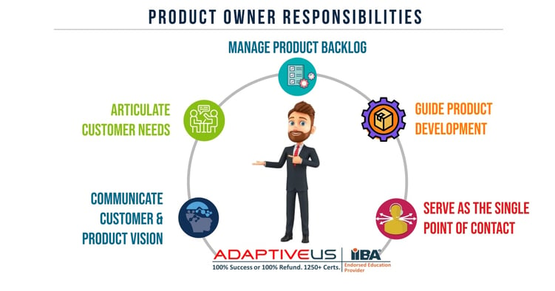
Product Owner / Client
Represents stakeholders and defines the vision of the product. Sets and communicates product requirements.
Intent: Ensure the development team understands what to build and why, aligning features with business goals.
Tools used: Product backlogs, Jira, Confluence, user stories, stakeholder interviews.
Notes:
https://www.adaptiveus.com/blog/what-is-a-product-owner/

Slide 5
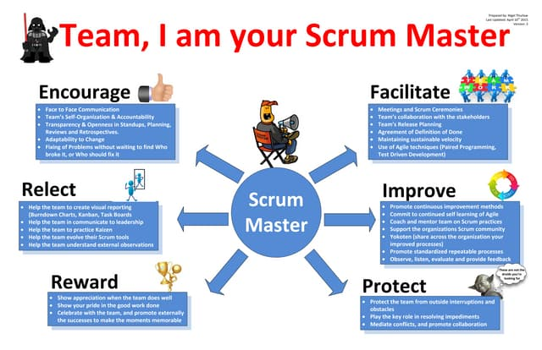
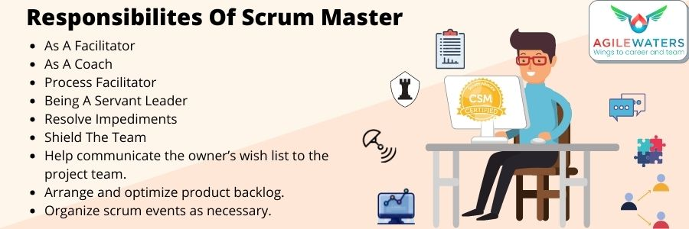
Scrum Master
Facilitates the agile process, removes impediments, and ensures team cohesion and efficiency.
Intent: Support the team in following Agile principles and maintain a productive work environment.
Tools used: Scrum boards, Agile ceremonies (stand-ups, retrospectives), Jira, communication platforms like MS Teams.
Notes:
https://agilewaters.com/what-are-the-roles-and-responsibilities-of-a-scrum-master/

Slide 6
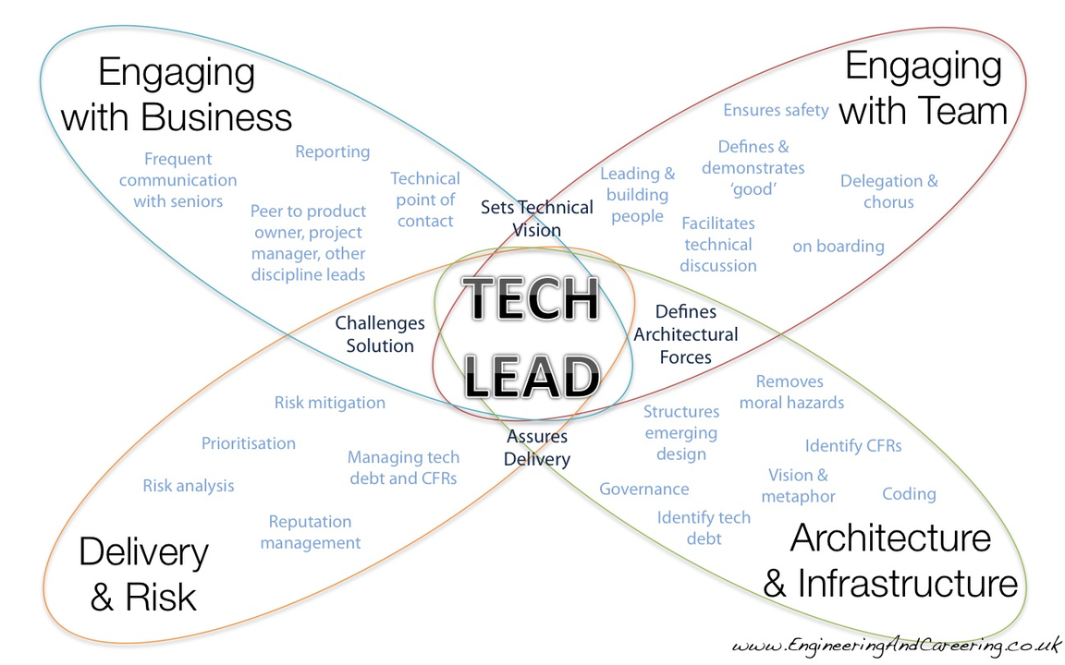
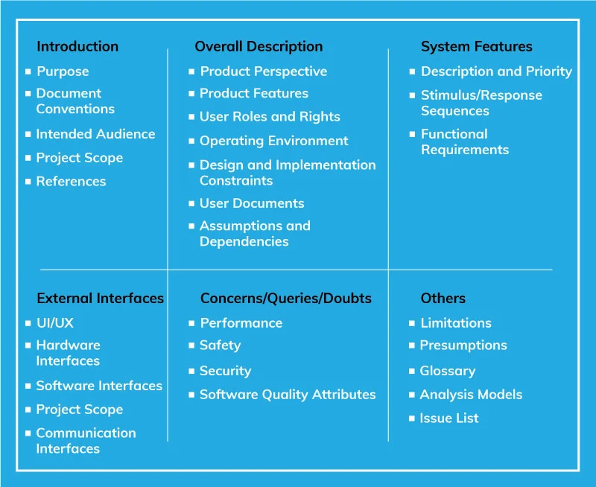
Technical Lead
Provides technical direction and decision-making for the development team.
Intent: Ensure technical integrity, code quality, and system architecture align with the project’s goals.
Tools used: Code repositories (GitHub, GitLab), architecture diagrams, design patterns, code review platforms.
Notes:
https://www.linkedin.com/pulse/how-effective-tech-lead-software-industry-chandan-kumar
https://www.shakebugs.com/blog/tech-lead-responsibilities/

Slide 7
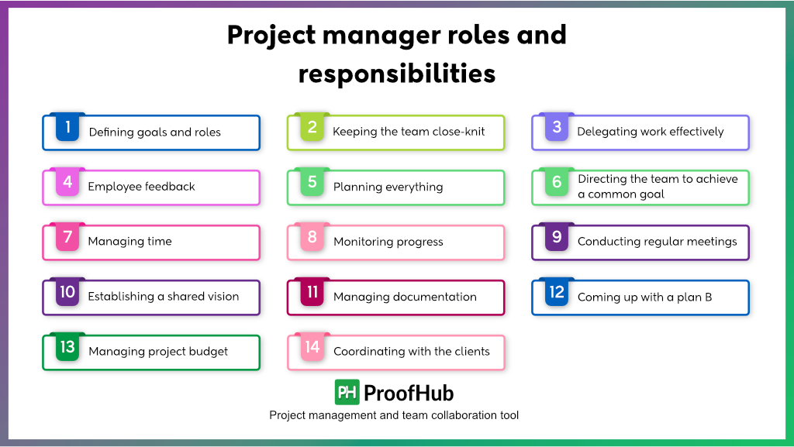
Project Manager
Oversees project planning, execution, monitoring, and closure. Manages scope, schedule, budget, and risk.
Intent: Deliver the project on time, within budget, and in scope while meeting quality standards.
Tools used: Microsoft Project, Gantt charts, risk registers, project charters, budgeting tools.
Notes:
https://www.proofhub.com/articles/project-manager-roles-responsibilities

Slide 8
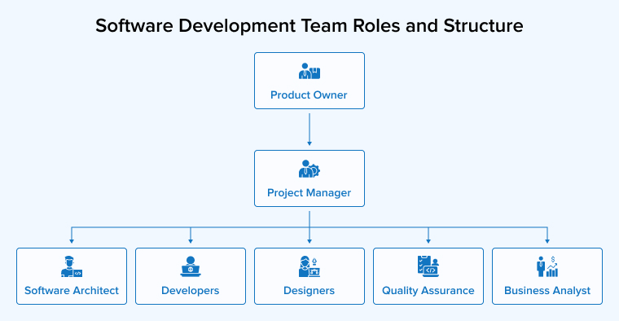
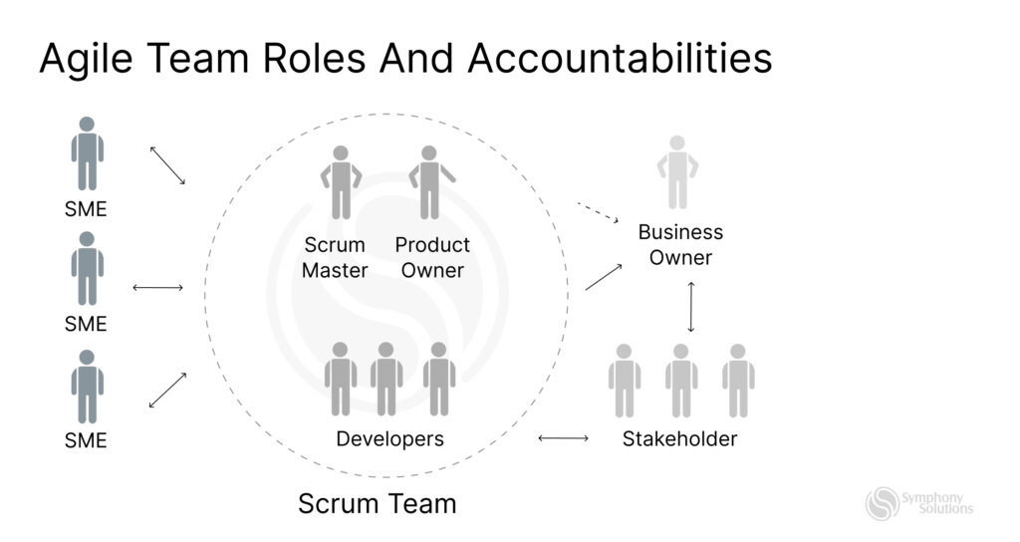
Software Development Team – Roles and Responsibilities
The software development team is a cross-functional group of professionals responsible for designing, building, securing, and maintaining the software product throughout its lifecycle.
Each role contributes to transforming business needs into a robust, user-friendly, and secure solution.
Intent To collaboratively build a high-quality software product that meets user needs, performs reliably, and adheres to best practices in security, design, and scalability.
Notes:
https://symphony-solutions.com/insights/agile-team-structure-in-software-development
https://www.tatvasoft.com/outsourcing/2022/05/software-development-roles.html

Slide 9
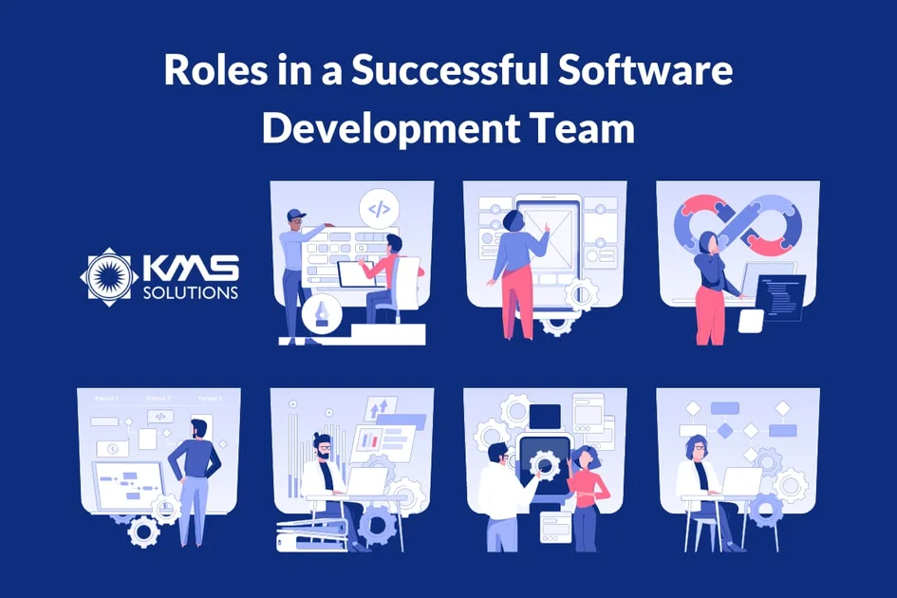
Software Development Team – Roles and Responsibilities
Key Roles:
Systems Analyst - Analyses the current system, gathers business requirements, and designs the structure and features of the new software solution.
UX/UI Designer - Conducts user research and market analysis to design intuitive, attractive, and user-centred interfaces that enhance usability.
Software Developer/Engineer - Converts designs and specifications into working code, building a functional, stable, and secure product.
Operations Engineer - Ensures the smooth deployment, performance, and reliability of the system in live environments; manages infrastructure and monitoring.
Security Engineer - Implements security measures, identifies vulnerabilities, and ensures compliance with data protection standards to safeguard the system.
Notes:
https://kms-solutions.asia/blogs/roles-in-a-dedicated-software-development-team

Slide 10
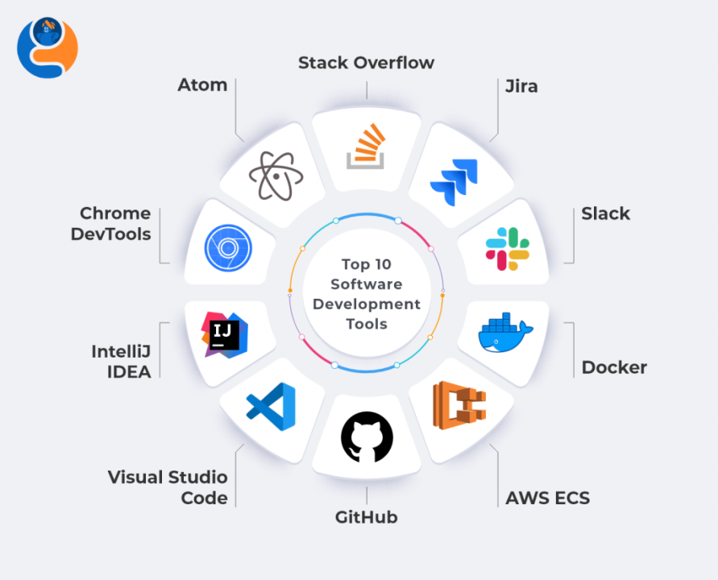
Software Development Team Tools
Tools
Systems Analyst: UML, BPMN, Lucidchart, Confluence
UX/UI Designer: Figma, Adobe XD, Sketch, user research tools
Developer: GitHub, VS Code, IntelliJ, CI/CD tools (Jenkins, GitLab CI)
Operations Engineer: Docker, Kubernetes, AWS/Azure, monitoring tools (Grafana, Prometheus)
Security Engineer: OWASP ZAP, Nessus, firewalls, SIEM tools (Splunk, QRadar)
Notes:
https://www.linkedin.com/pulse/software-development-tools-poornima-devi-xyunc
https://www.inspirisys.com/blog-details/Top-10-Software-Development-Tools-to-Boost-Productivity-and-Innovation/159

Slide 11
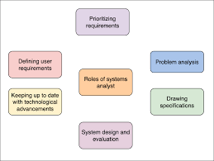

Systems Analyst
Evaluates the existing system and gathers requirements to design new software solutions.
Intent: Bridge the gap between the technical team and business stakeholders by translating business needs into system specifications.
Tools used: UML diagrams, data flow diagrams, requirement gathering techniques, BPMN tools.
Notes:
https://www.educative.io/answers/what-are-the-roles-of-a-systems-analyst
https://www.modernanalyst.com/Resources/Articles/tabid/115/ID/3726/Differences-Duties-and-Responsibilities-of-Business-Analysts-and-System-Analysts.aspx

Slide 12
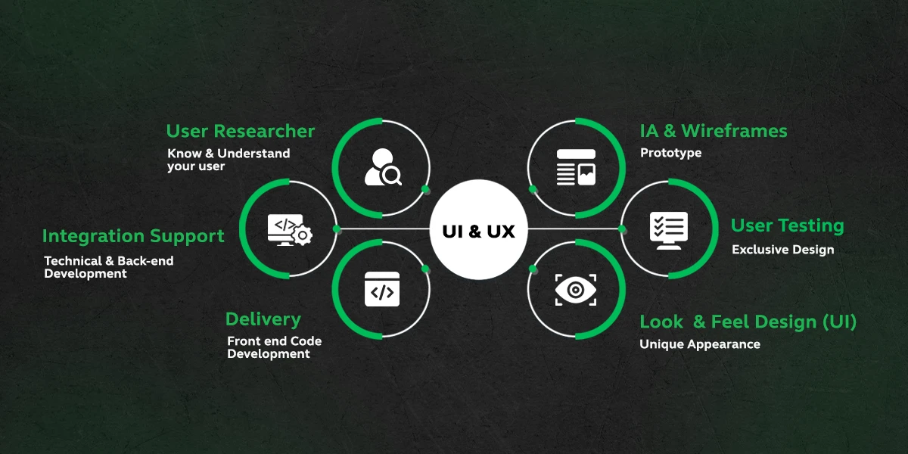
UX/UI Designer
Researches user needs and market trends to design intuitive and attractive user interfaces.
Intent: Improve user satisfaction through usability, accessibility, and aesthetics.
Tools used: Figma, Adobe XD, Sketch, usability testing tools, wireframing software.
Note: UX/UI stands for User Experience and User Interface
Notes:
https://www.guvi.in/blog/ui-ux-designer-roles-and-responsibilities-and-job-description/

Slide 13
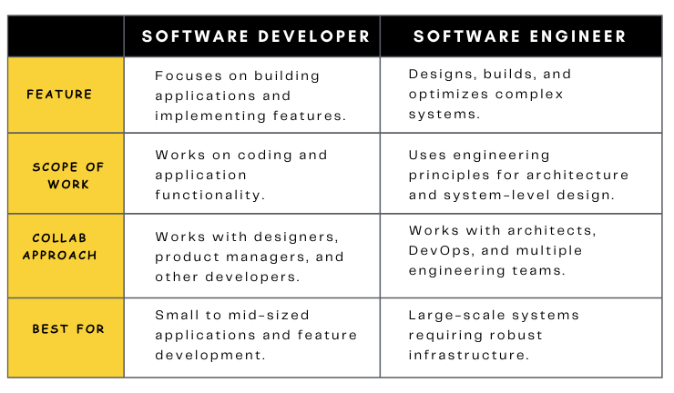
Software Developer / Engineer
Converts designs and requirements into a functional, secure, and stable software product.
Intent: Build and maintain code that fulfils user needs and meets technical and security standards.
Tools used: IDEs (Visual Studio, IntelliJ), Git, CI/CD pipelines, testing frameworks.
Notes:
https://www.ishir.com/blog/146410/software-developer-vs-software-engineer.htm
https://blog.temok.com/software-developer-vs-software-engineer/

Slide 14
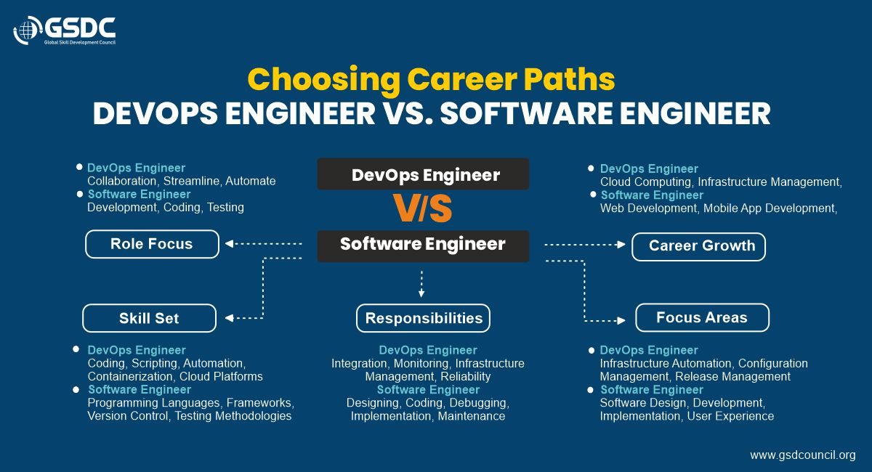
Operations Engineer
Manages deployment, infrastructure, and monitoring to maintain system uptime and performance.
Intent: Ensure the system runs smoothly and responds quickly to operational issues.
Tools used: Docker, Kubernetes, AWS/Azure, monitoring tools (Prometheus, Grafana, New Relic).
Notes:
https://www.gsdcouncil.org/blogs/devops-engineer-vs-software-engineer

Slide 15
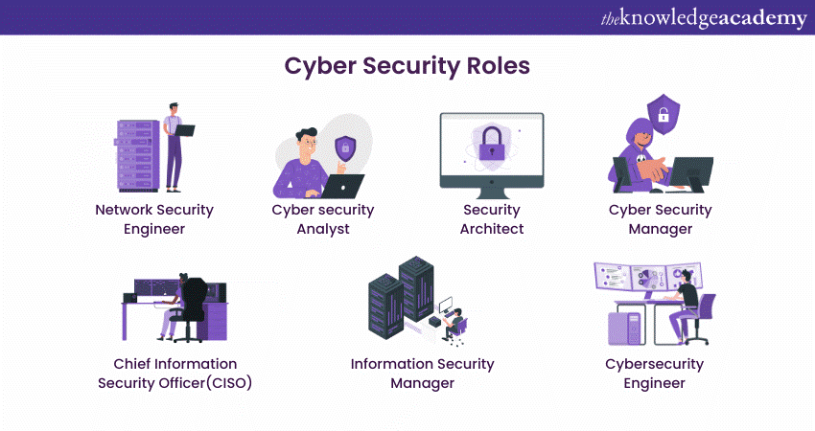
Security Engineer
Implements and monitors security practices across the software and infrastructure.
Intent: Protect data, prevent breaches, and ensure compliance with security standards.
Tools used: Vulnerability scanners, firewalls, SIEM tools (Splunk), OWASP guidelines.

Slide 16
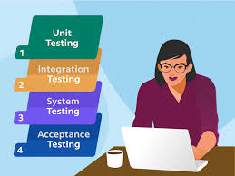
Software Testers
Validates the functionality, performance, and stability of the software through testing.
Intent: Ensure a quality product is delivered by identifying and resolving defects.
Tools used: Selenium, JUnit, TestRail, Postman, automated and manual testing tools.

Slide 17
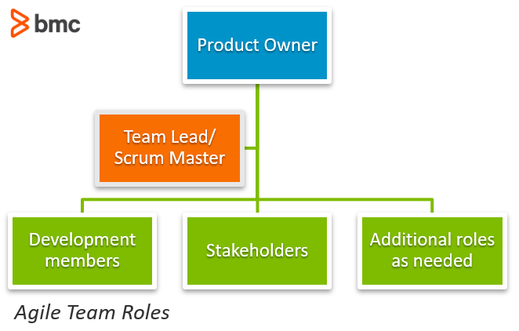
Activity - roles and responsibilities
Objective:
Understand and apply the roles and responsibilities of digital team members involved in software development.
Instructions:
Work in your teams
Design a Minimum Viable Product (MVP) for an online food delivery app
Each team member will take on multiple roles from a real-world development team
Collaborate, plan, and present how your team will deliver the MVP
Notes:
https://www.bmc.com/blogs/agile-roles-responsibilities/

